Slide 1
Mongodb
. Basic introduction
. CURD Operations
. Cluster scheme
. Performance

Slide 2
Basic introduction
Mongodb is a high performance, high availability, horizontal scalability, Support for Multiple Storage Engines, has rich query language of a document database.

Slide 3
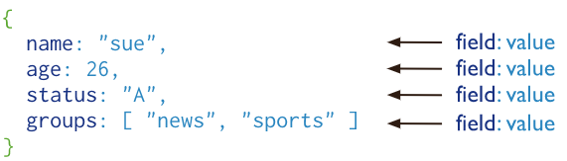
Documents
MongoDB stores data records as BSON documents. BSON is a binary representation of JSON documents, though it contains more data types than JSON.
Restrictions on field names:
‘ _id’: Is reserved for use as a primary key.
’$’: cannot start with the dollar sign ($) character.
’.’, null: cannot contain the ‘.’ and null character
Mongodb Limits:
The maximum BSON document size is 16 megabytes.
MongoDB supports no more than 100 levels of nesting for BSON.
Database names cannot be empty and must have fewer than 64 characters.
The database name, the dot (.) separator, and the collection name, is 120 bytes.
ref: https://docs.mongodb.com/manual/reference/limits/#Index-Key-Limit

Slide 4
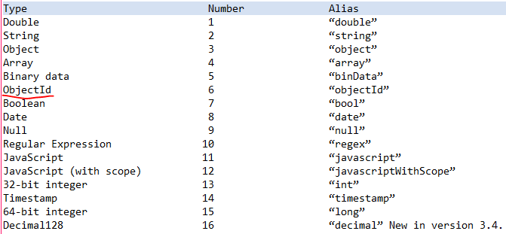
BSON
BSON is a binary serialization format used to store documents and make remote procedure calls in MongoDB.
bson type:
ObjectId,
ObjectIds are small, likely unique, fast to generate, and ordered. ObjectId values consist of 12 bytes.
In MongoDB, each document stored in a collection requires a unique _id field that acts as a primary key. If an inserted document omits the _id field, the MongoDB driver automatically generates an ObjectId for the _id field.

Slide 5
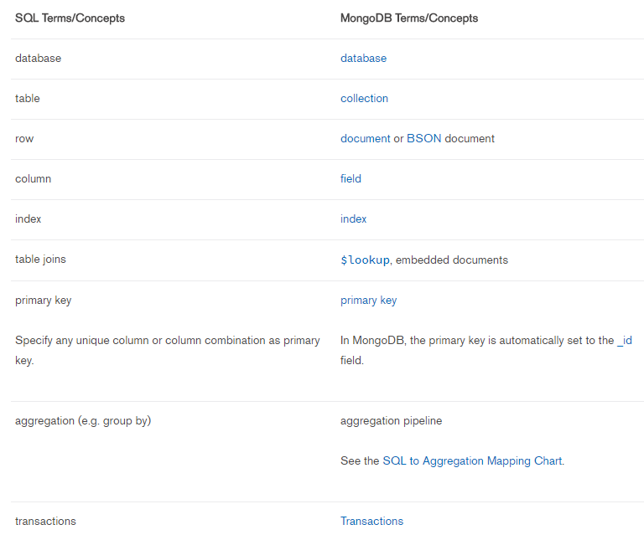
SQL to MongoDB Mapping Chart
Terminology and Concepts

Slide 6
Examples：
SQL Schema Statements
MongoDB Schema Statements
CREATE TABLE people (
id MEDIUMINT NOT NULL
AUTO_INCREMENT,
user_id Varchar(30),
age Number,
status char(1),
PRIMARY KEY (id)
)
db.people.insertOne( {
user_id: "abc123",
age: 55,
status: "A"
} )
db.people.updateMany(
{ },
{ $set: { join_date: new Date() } }
)
ALTER TABLE people
ADD join_date DATETIME
CREATE INDEX idx_user_id_asc
ON people(user_id)
db.people.createIndex( { user_id: 1 } )
CREATE INDEX
idx_user_id_asc_age_desc
ON people(user_id, age DESC)
db.people.createIndex( { user_id: 1, age: -1 } )

Slide 7
Databases and Collections
In MongoDB, databases hold collections of documents.
use myNewDB //create a database myNewDB
db.dropDatabase() //drop current used database.
// create a collections and insert a document.
db.myNewCollection1.insertOne( { x: 1 } )
db.createCollection(“testCollection”) // explicit creation collections
db.testcollection2.drop() // drop collection testcollection2

Slide 8
MongoDB Drivers and Client Libraries
Mongodb provides a client library of various languages, Help different developers to use mongodb better.
Language support:
C, C++, C#, Java, Node.js, Perl, PHP, Python, Ruby, Scale, Go, Erlang, mongo Shell

Slide 9
CRUD Operations
Create Operations:
db. collection.insertOne()
db.testcollection.insertOne({name:"juggler", age:26, frends:["book","luke","jim","fisher"]})
return:
{
"acknowledged" : true,
"insertedId" : ObjectId("5b470e865d8861207b2486f8")
}
You can also insert more document with db.collection.insertMany (), separated by commas (‘,’) between documents.
If the document contains an _id field, the _id value must be unique within the collection to avoid duplicate key error.
Read Operations:
db.collection.find()
db.testcollection.find({age:{$ne:25}, name:"juggler"}, {frends:1})
{ "_id" : ObjectId("5b470e865d8861207b2486f8"), "frends" : [ "book", "luke", "jim", "fisher" ] }
Comparison：$eq, $gt, $gte, $in, $lt, $lte, $ne,$nin
Logical: $and, $not, $nor, $or
Element: $exists, $type

Slide 10
Update Operations:
db.collection.updateMany()
db.collection.updateOne()
db.collection.replaceOne()
db.testcollection.updateMany({age:{$lt:40}},{$set:{like:"pingpang"}})
{ "acknowledged" : true, "matchedCount" : 2, "modifiedCount" : 2 }
Delete Operations:
db.collection.deleteOne()
db.collection.deleteMany()
db.testcollection.deleteMany({age:{$lt:27}})
{ "acknowledged" : true, "deletedCount" : 1 }

Slide 11
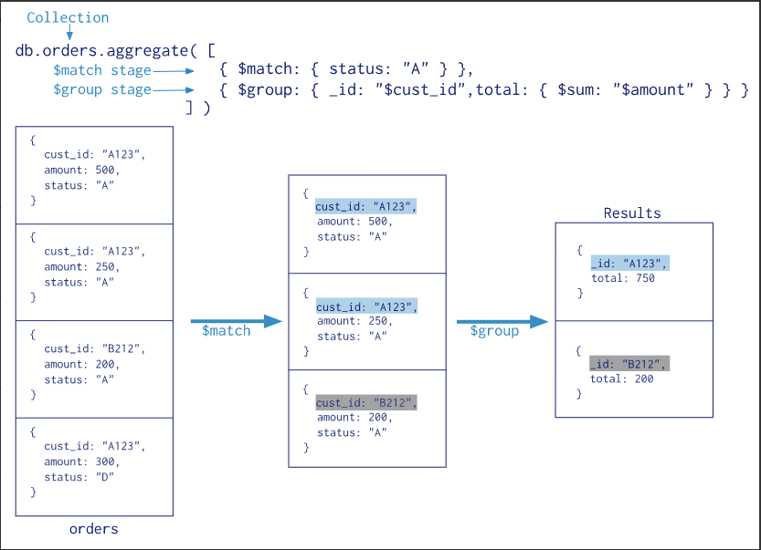
Aggregation
Aggregation Pipeline:

Slide 12
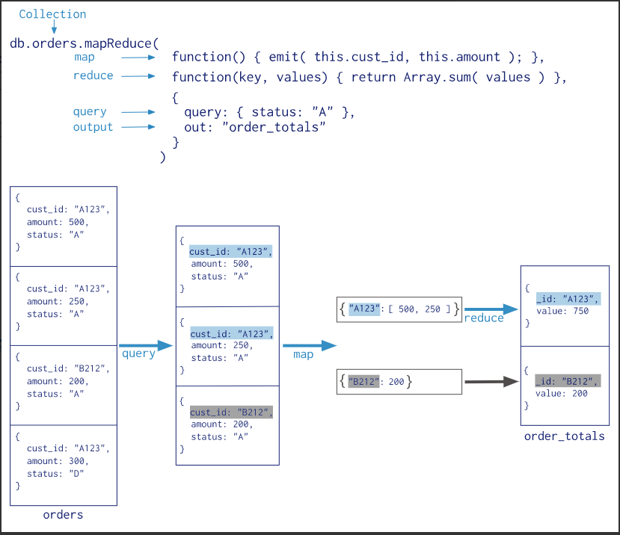
Map-Reduce:

Slide 13
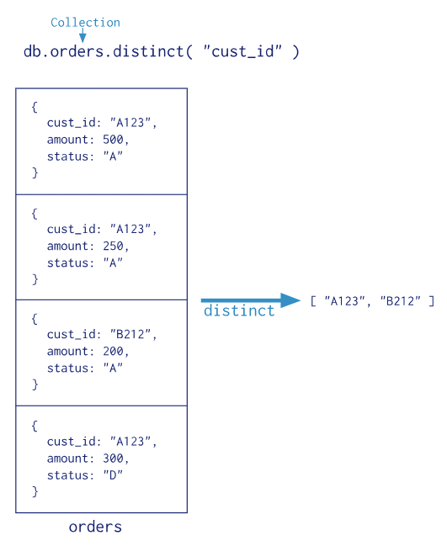
Single Purpose Aggregation Operations:
MongoDB also provides db.collection.count() and db.collection.distinct().

Slide 14
Indexes
MongoDB indexes use a B-tree data structure. Default _id Index.
Index Types,
Single Field,
Compound Index,
{userid: 1, score: -1 }
Multikey Index
These Multikey Indexes allow queries to select documents that contain arrays by matching on element or elements of the arrays.
Geospatial Index
Text Indexes
MongoDB provides a text index type that supports searching for string content in a collection.
Hashed Indexes
which indexes the hash of the value of a field.
Index Properties
Unique Indexes
Partial Indexes
Sparse Indexes
TTL Indexes

